Slide 1
PRABHAKAR AZAD
Big-Mart-Sales prediction
Submitted by
Mr. vishnu prakash sharma

Slide 2
BigMart has collected sales data from the year 2013, for 1559 products across 10 stores in different cities
It’s a regression practice problem
The Data Sources is :
https://www.kaggle.com

Slide 3
The Problem Statement
The aim is to build a predictive model and find out the sales of each product at a particular store.
Using this model, BigMart will try to understand the properties of products and stores which play a key role in increasing sales.

Slide 4
We will explore the problem in following stages:
Hypothesis Generation – understanding the problem better by brainstorming possible factors that can impact the outcome
Data Exploration – looking at categorical and continuous feature summaries and making inferences about the data.
Data Cleaning – imputing missing values in the data and checking for outliers
Feature Engineering – modifying existing variables and creating new ones for analysis
Model Building – making predictive models on the data

Slide 5
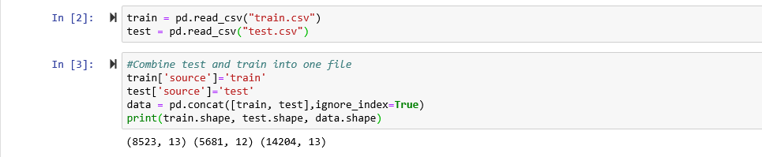
Data Structure and Content
Dataset has 8523 rows and 12 features and test has rain 5681 rows and 11 columns

Slide 6
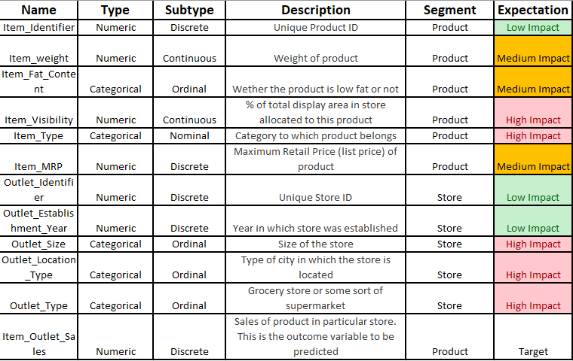
Data Dictionary

Slide 7
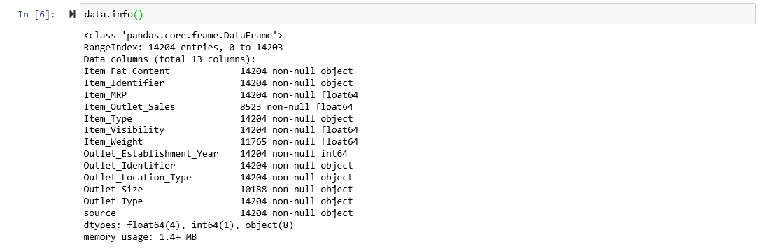

Slide 8
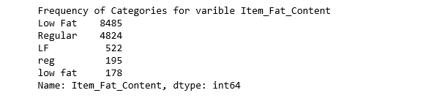
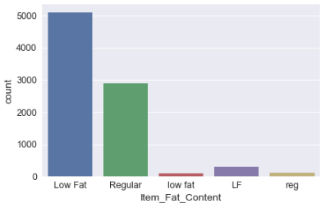
13 columns, 5 are numeric and 8 categorical
data.Item_Fat_Content.value_counts()

Slide 9
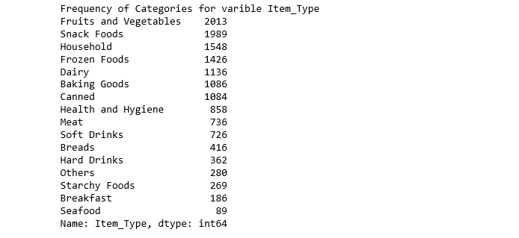
data.Item_Type.value_counts()

Slide 10
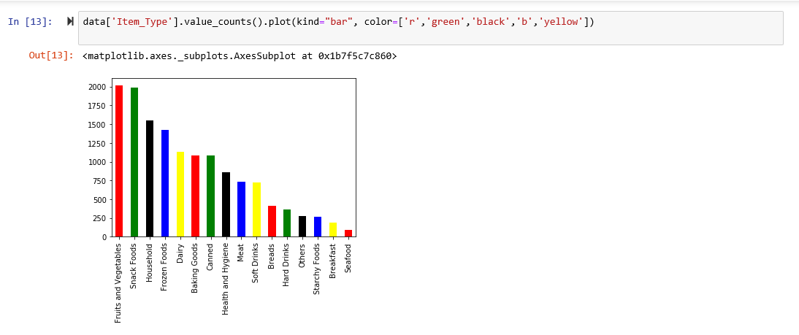

Slide 11
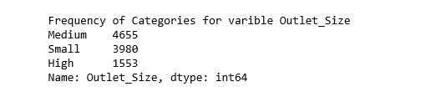
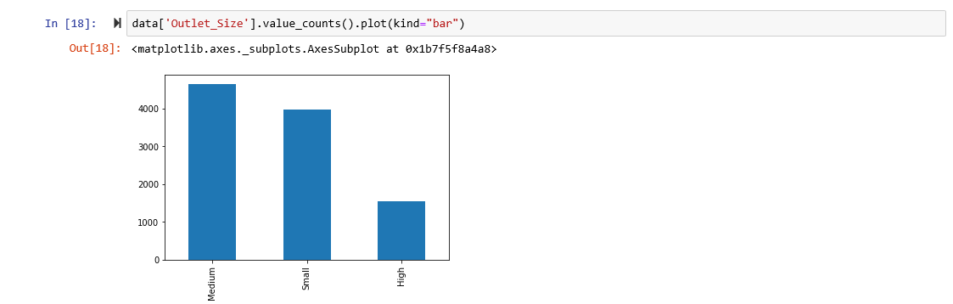
data.Outlet_Size.value_counts()

Slide 12
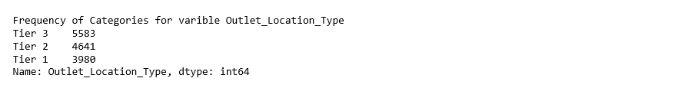
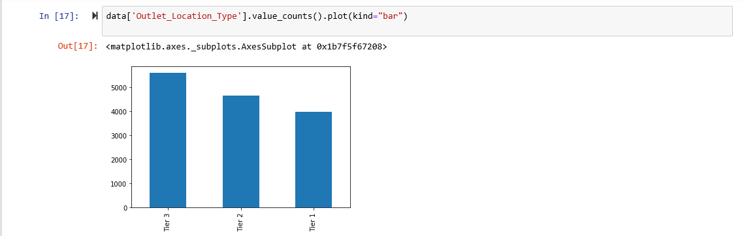
data.Outlet_Location_Type.value_counts()

Slide 13
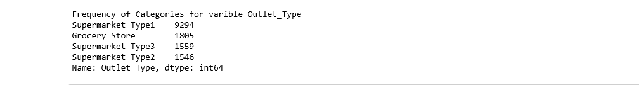
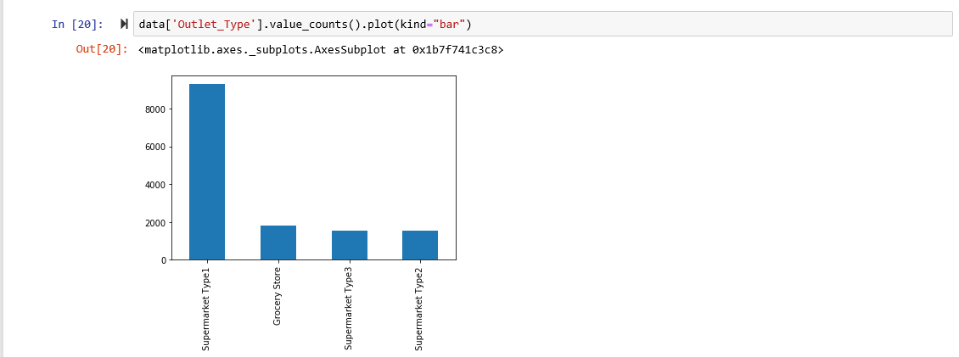
data.Outlet_Type.value_counts()

Slide 14
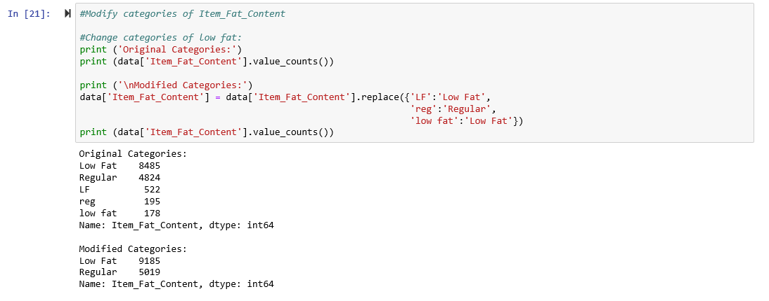
#Fat_Content showing redudancy of differnt types
#Fat_Content showing redudancy of differnt types
#Fat_Content showing redudancy of differnt types
#Fat_Content showing redudancy of differnt types
Feature Engineering
Fat_Content showing redudancy of differnt types

Slide 15
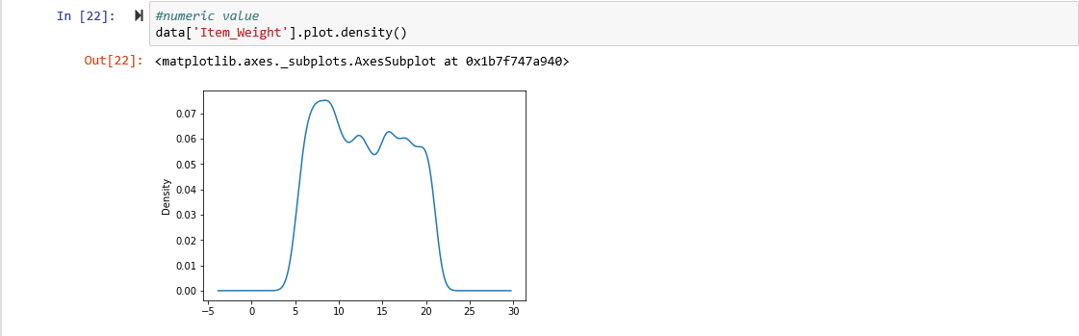

Slide 16
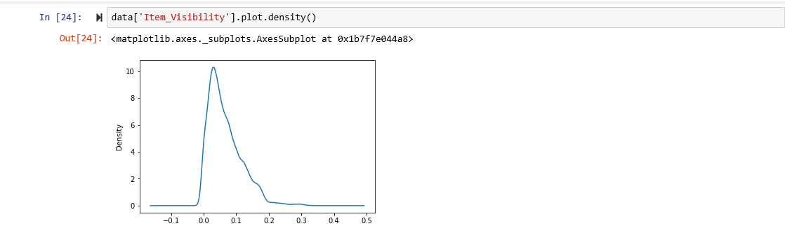

Slide 17
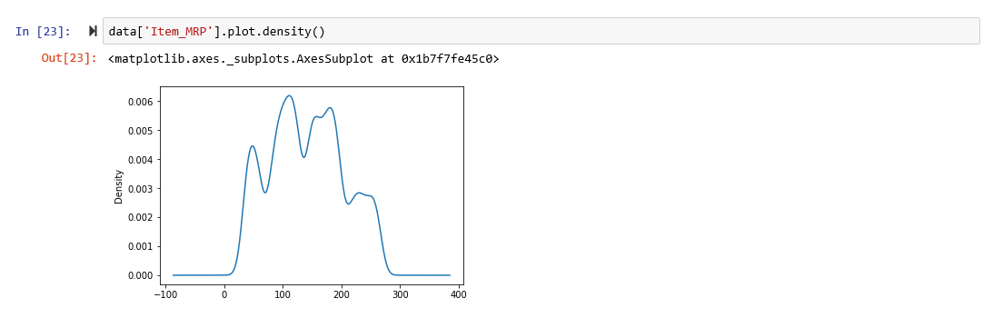

Slide 18
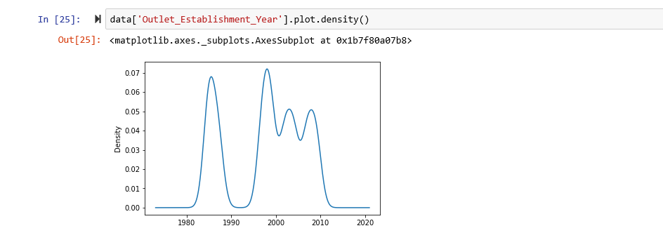

Slide 19
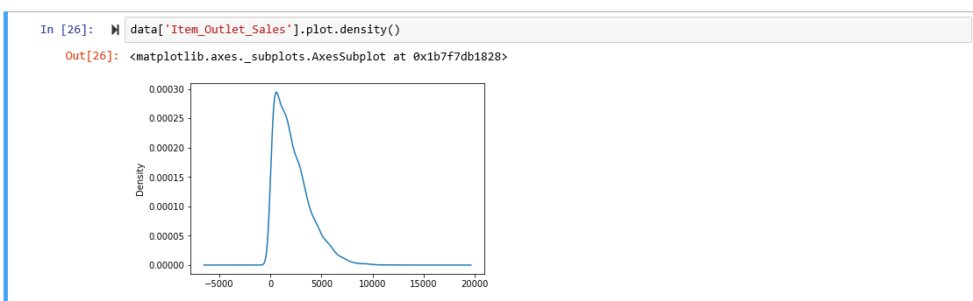

Slide 20
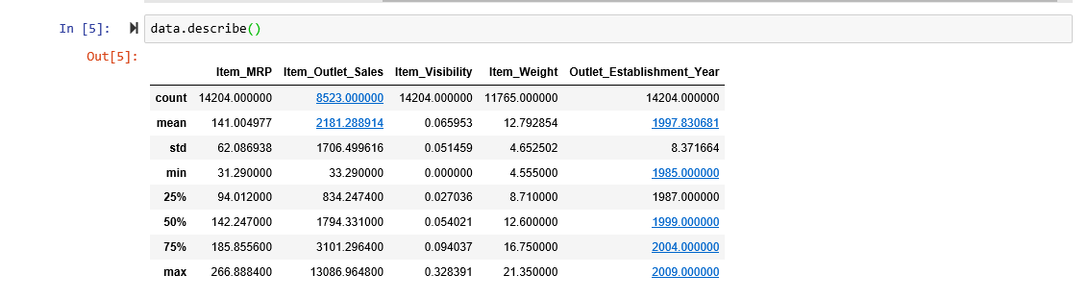

Slide 21
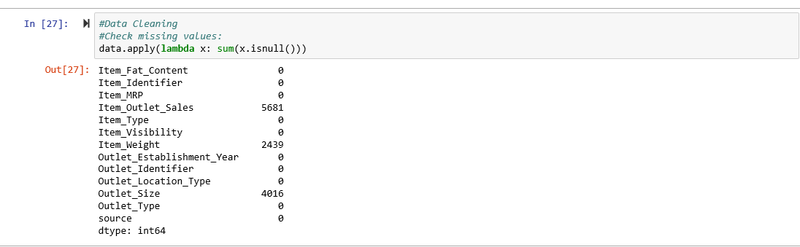
Data Cleaning

Slide 22
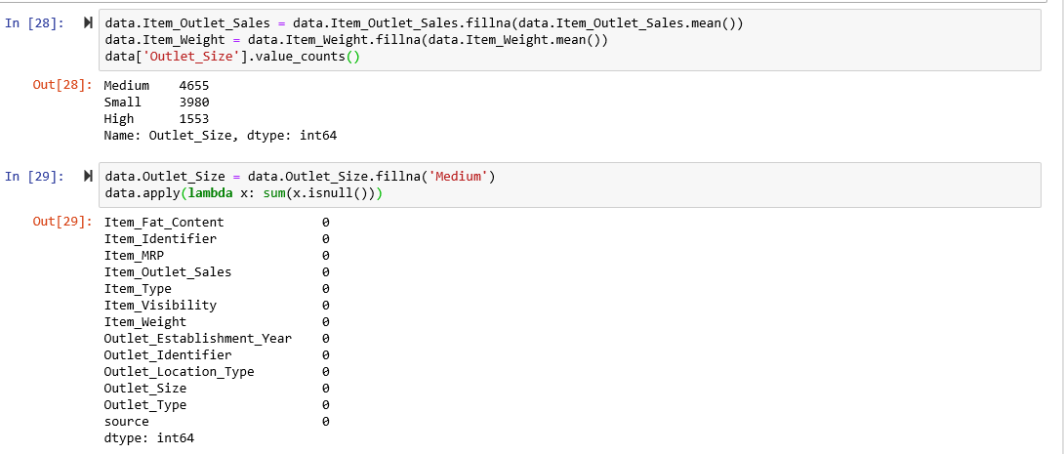

Slide 23
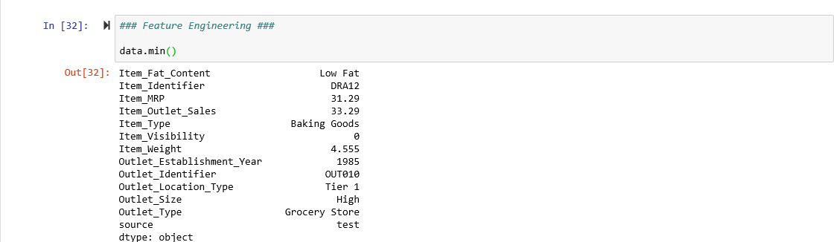
Feature Engineering

Slide 24
Notice that Item_Visibility has a minimum value of zero. It seems absurd that an item has zero
visibility. Therefore, we will modify that column.
Here we Group by Item_Identifier, calculate mean for each group(excluding zero values), then we proceed
to replace the zero values in each group with the group's mean.

Slide 25
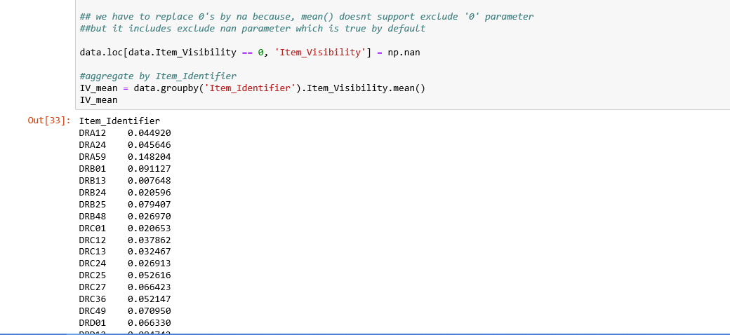

Slide 26
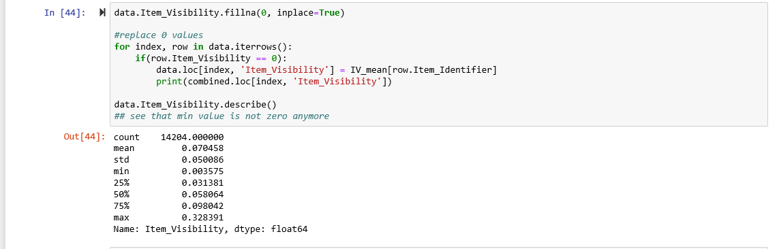

Slide 27
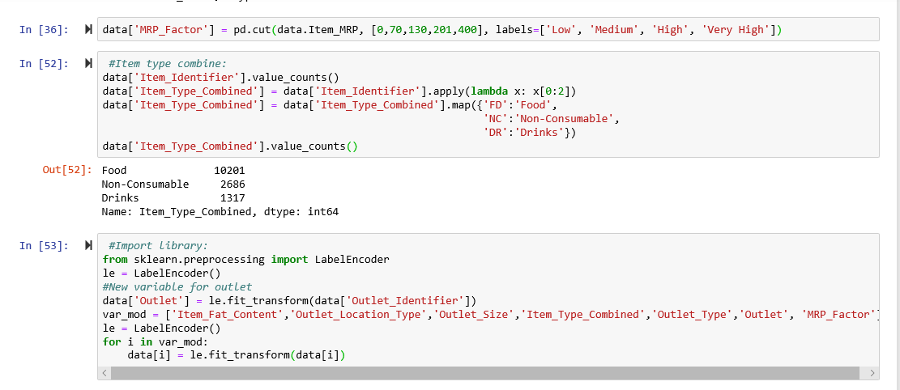

Slide 28
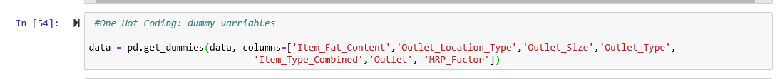
One Hot Encoding: dummy varriables
convert all categories of nominal variables into numeric types

Slide 29
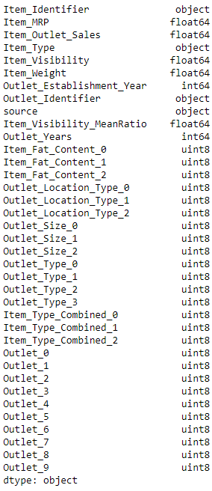
Here we can see that all variables are now float and each category has a new variable.

Slide 30
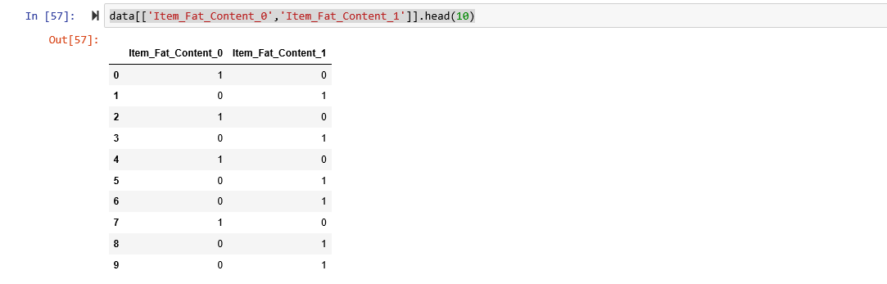

Slide 31
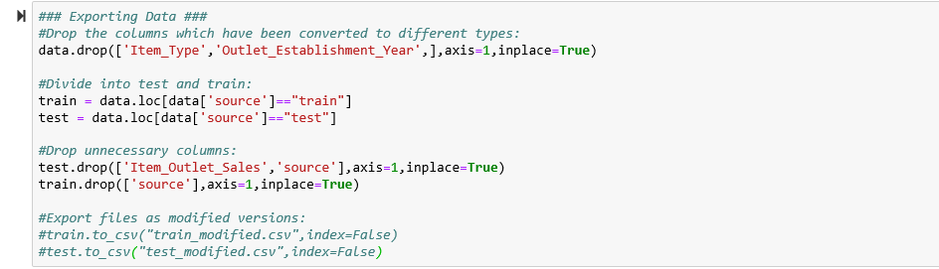

Slide 32
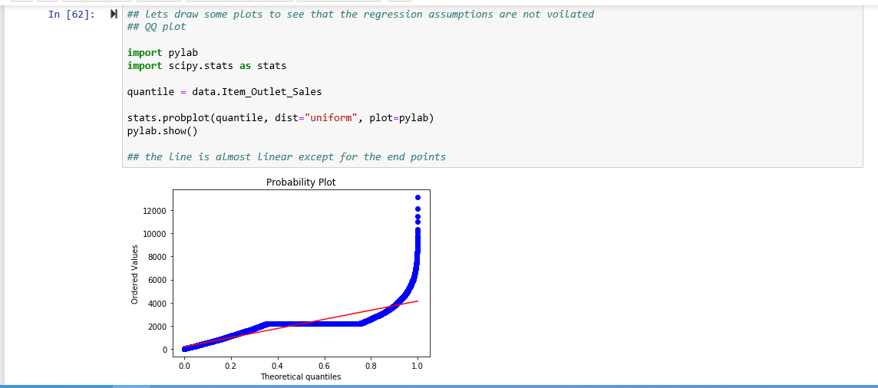

Slide 33
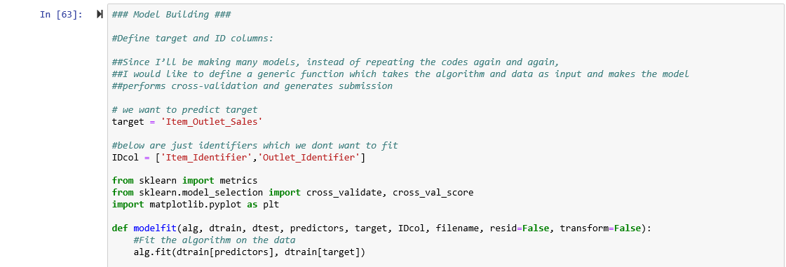

Slide 34
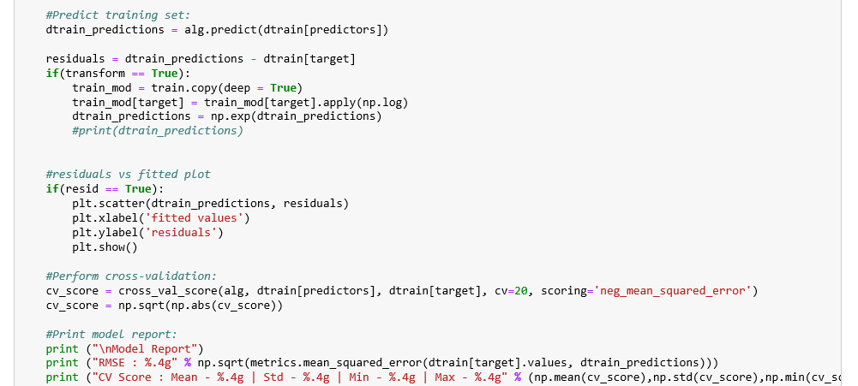

Slide 35
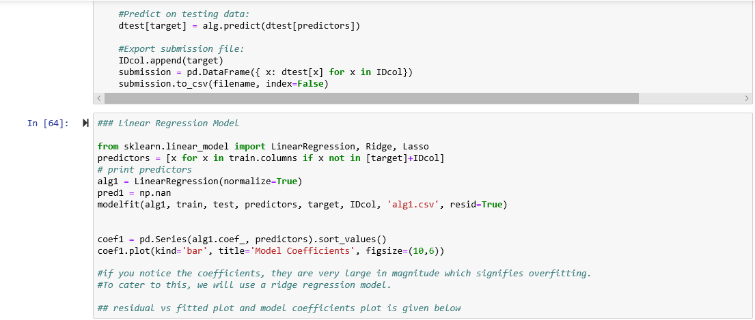

Slide 36
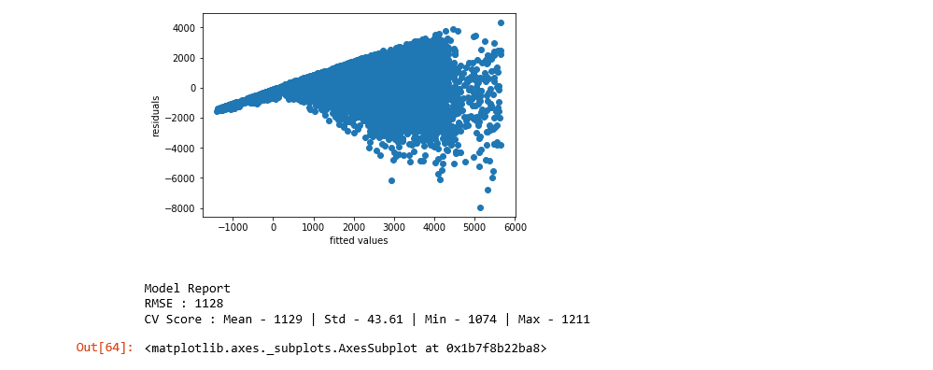

Slide 37
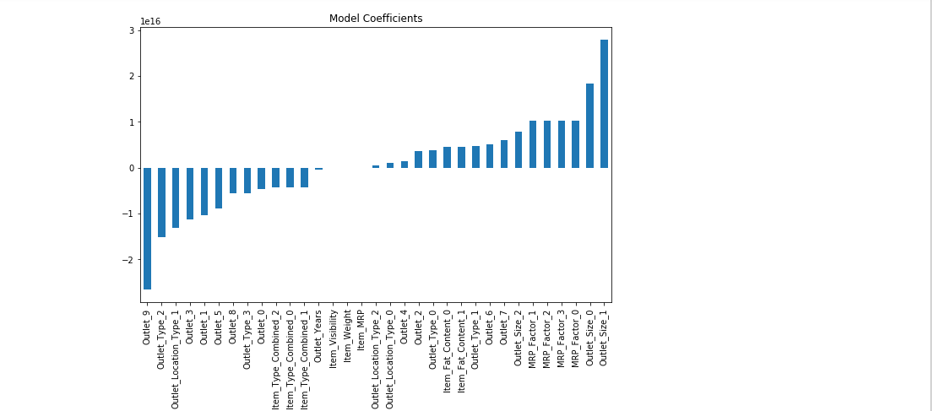

Slide 38
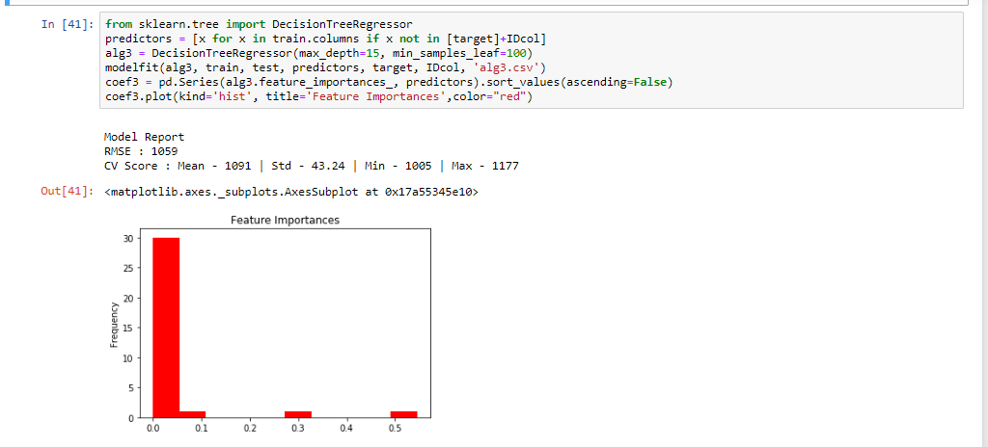

Slide 39
